Slide 1
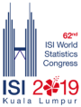


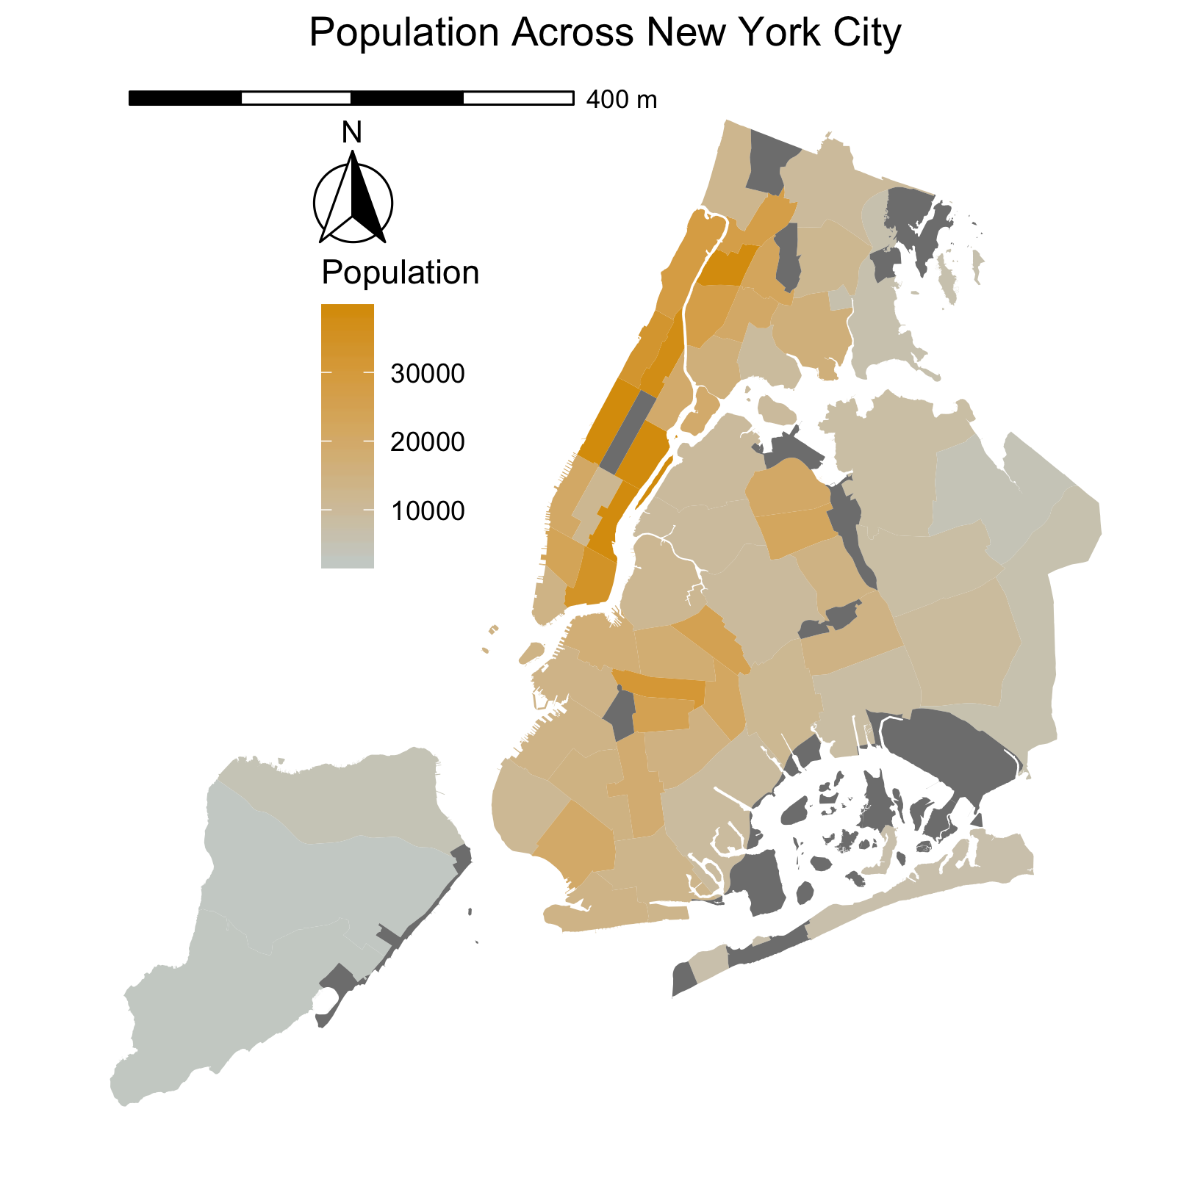
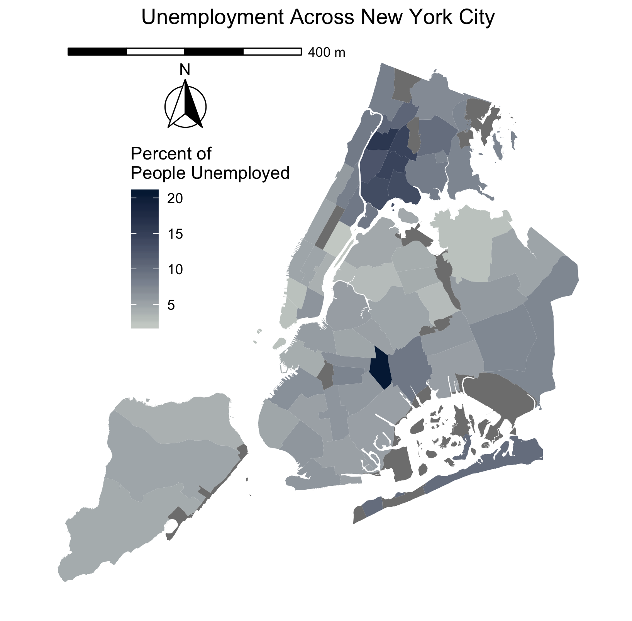




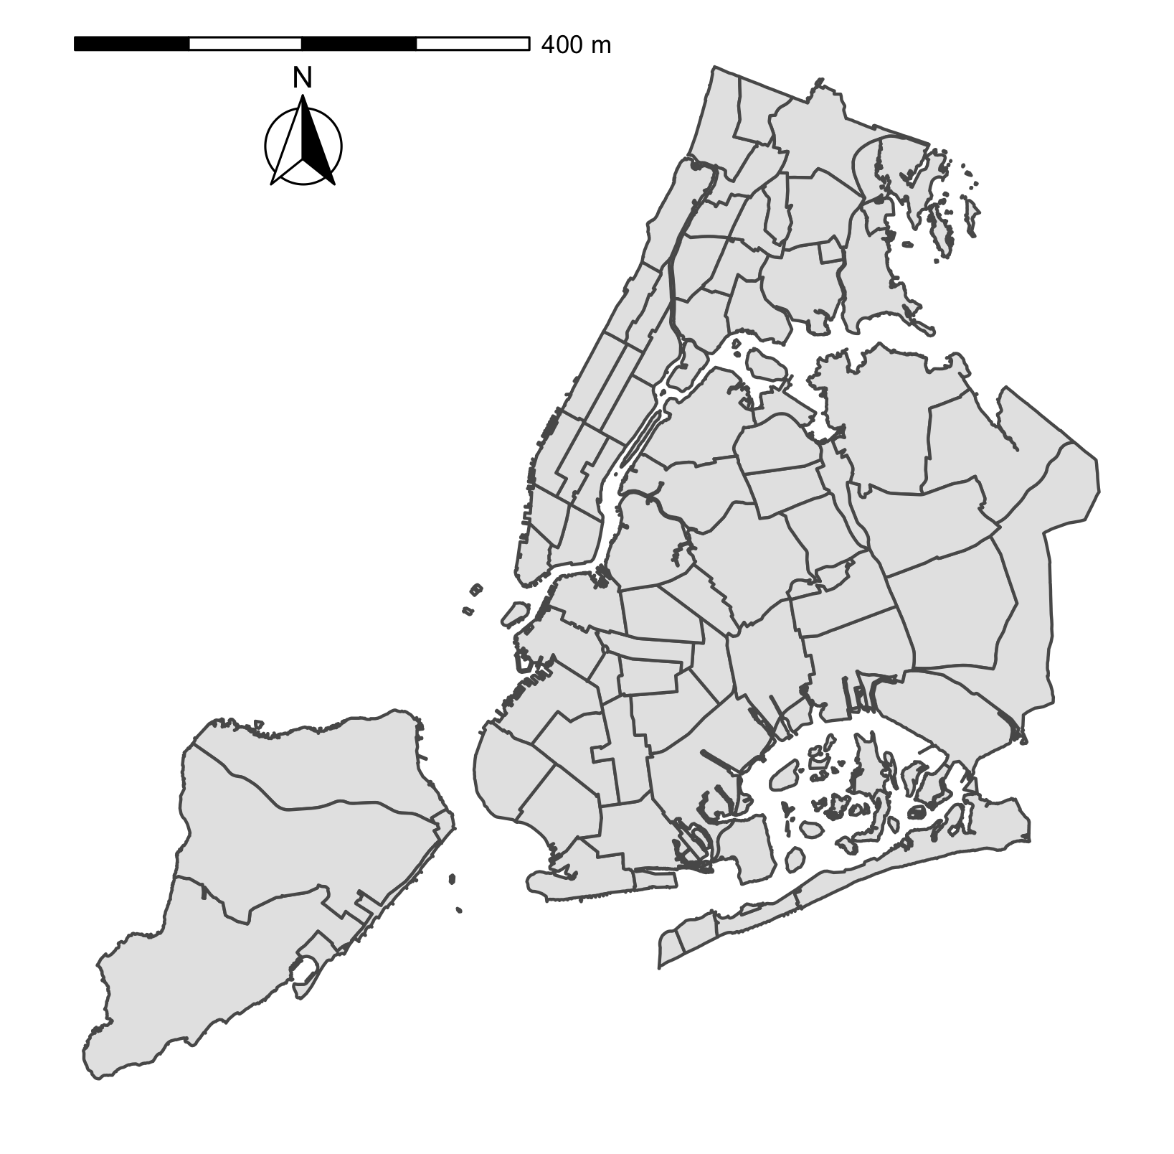
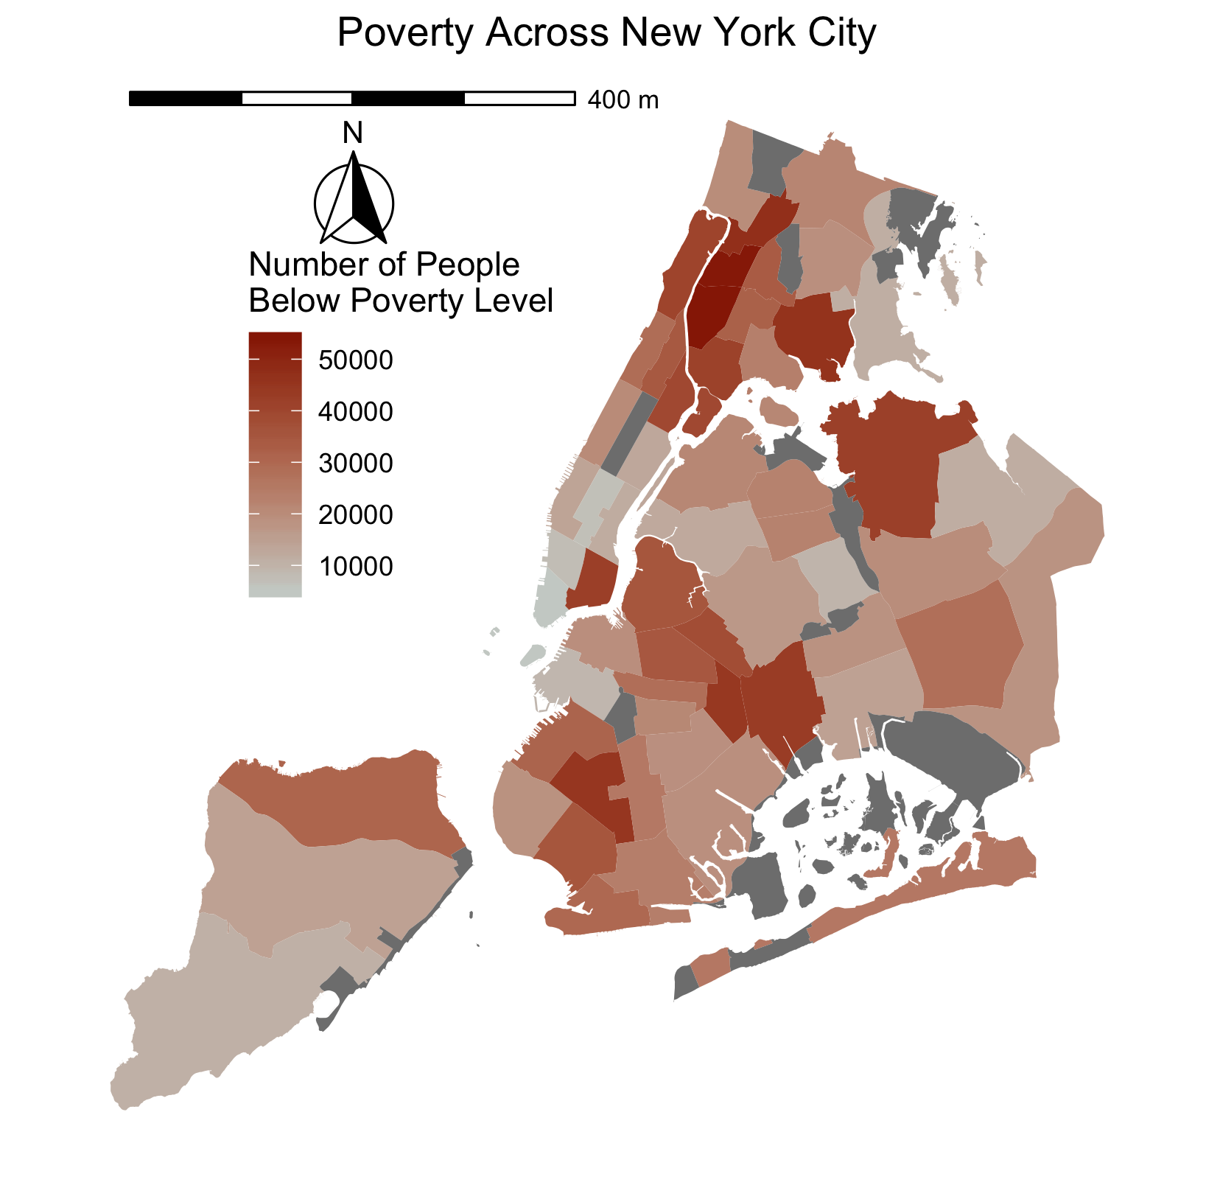
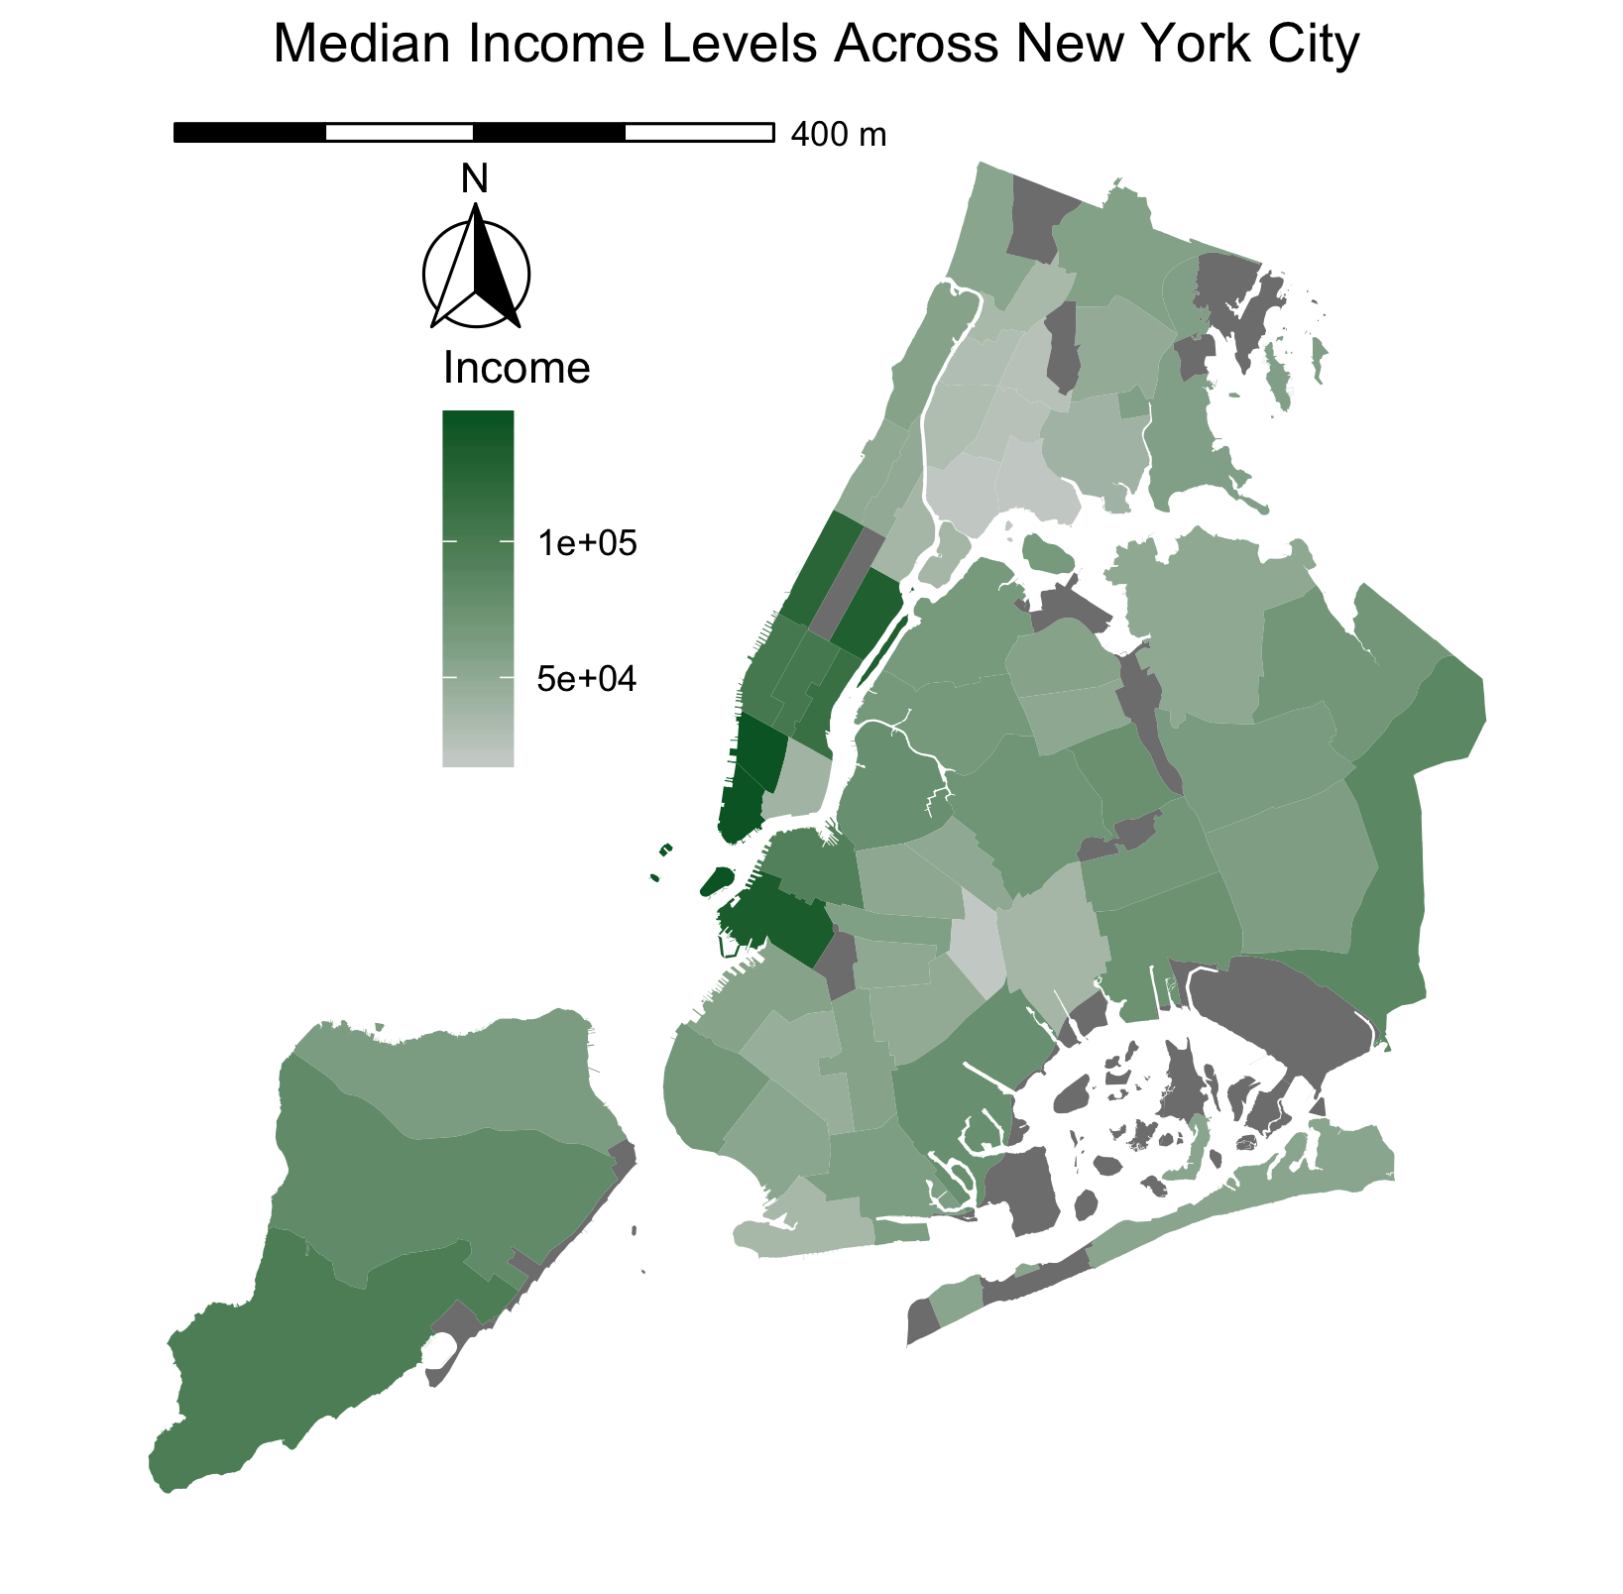
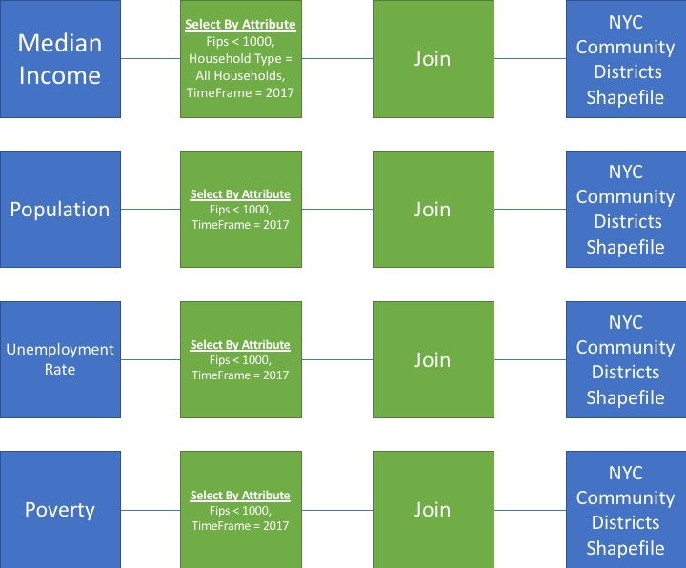
An Interdisciplinary Approach of Observing Quality of Life Indicators In an Urban Environment using Geographic Information Systems
Kamal Abdelrahman^{1,1}, Stephanie Rodriguez, MS^{1,2}
City University of New York – Brooklyn College¹
Department of Psychology¹, Department of Earth and Environmental Sciences²
Inter-Faceted Data
The Disparities
Figure 1: Examining quality of life through unemployment, poverty, income, and population
Figure 2: Focusing on New York City on the community district level, balance between granularity and information of census and boroughs
Figure 2: Poverty levels appear significantly low in lower Bronx ,
high in lower Manhattan
GIS Model
Findings and Future Goals
Conclusion
Disparities are common among community districts in New York City
Power in open sourced analysis, data and programming, of open sourced data for individuals who lack the resources to collect and analyze it, and still maintain a sense of participation. (Obermeyer, 1998)
Limitations
Very little flexibility with analysis of aggregated values
Small sample size to optimally support suggestable assumptions
Future Goals
Predictive models on analysis to identify future needs within communities
Explore analysis on a more granular level, potentially with the census tracts
kamalabdel97
Kamal Abdelrahman
kamalabdel97@gmail.com

